Slide 1


Training Outline - agenda
Introduction – 4
Command syntax;
Prefix – 5
Name – 6
TAG and SUBTAG – 7
Parameter – 8
Serial command / Menu Barcodes – 10
Concatenating Commands – 11
Query Commands -12
Device Responses -14
Trigger Commands – 15
Available serial commands -16
Image Commands – 17
Prefix and Suffix – 18
Data Editing Commands
Data Format – 19
Data Format Sample – 20
Modifier Keys - 21

Slide 2



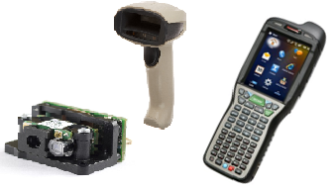
Introduction
Honeywell auto-ID devices are programmed or configured through a global command langue
Menu Barcode Configuration Utility SDK / driver / control
Serial command

Slide 3
Command Syntax - Prefix
(Prefix) [:Name:] (TAG)(SUBTAG) {Parameter} (Terminator)
The Prefix identifies data as a command, and determines the ‘type’ of command.
The prefix is structured as followed:
[SYN] ASCII character [CR]
The middle ASCII character determines the ‘type’ of command.
The most commonly used type is M for ‘Menu Command’
In bar codes the [SYN]M[CR] is represented by a ‘~’ (tilde)

Slide 4
Command Syntax - Name
(Prefix) [:Name:] (TAG)(SUBTAG) {Parameter} (Terminator)
Name is optional and strictly used with wireless devices that utilize a base station. When a serial command is send to the tethered base station, but it is actually meant for the wireless connected scanner, then that can be achieved by applying a name.
The name structured as followed:
:Name:
For ‘Name’ the Bluetooth friendly name (BT_NAM) should be used, but most often the wildcard option is being used :*:

Slide 5
Command Syntax – TAG SUBTAG
(Prefix) [:Name:] (TAG)(SUBTAG) {Parameter} (Terminator)
This is the actual ‘serial-command’, consisting of a 3 character TAG and 3 character SUBTAG. De TAG is the ‘family’ and for example all ‘RS232 interface’ commands use the TAG 232
De SUBTAG defines the specific setting. Per example;
232BAD selects the RS232 baud rate, with a parameter
232WRD selects the RS232 word with a parameter

Slide 6

Command Syntax – Parameter
(Prefix) [:Name:] (TAG)(SUBTAG) {Parameter} (Terminator)
There are serial commands that do not require a parameter such as:
DEFALT to recall (custom) defaults
PAP232 Plug and Play command to configure for RS232
Many serial commands that switch something on/off have a Boolean parameter such as;
128ENA1 enable code 128
232CTS0 disable RTS/CTS for the RS232 interface
Other serial command use a value within a range such as;
DLYRRD500 configure a re-read delay of 500 milliseconds
PDFMAX2750 configure a max length of 2750 for PDF417
BEPFQ12250 configure a beeper frequency of 2250 Hz.

Slide 7
Command Syntax – Parameter
(Prefix) [:Name:] (TAG)(SUBTAG) {Parameter} (Terminator)
As the serial command can be different in length, it needs to be terminated with an additional character.
De terminator also determines where the setting is stored;
A period ‘.’ stores the setting in non-volatile memory (Flash)
An exclamation point ‘!’ stores settings in volatile memory (RAM)
Also commands that do not have to be stored, require a terminator character such as; DEFALT. or RESET_.
In a configuration bar code the terminator also needs to be present, and additionally a [FNC3] is required.

Slide 8

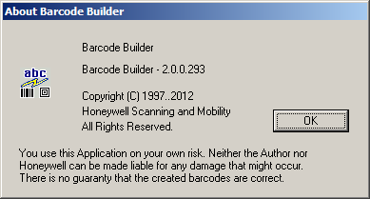

Serial Command v.s. Menu Barcode
(Prefix) [:Name:] (TAG)(SUBTAG) {Parameter} (Terminator)
Serial Command
[SYN]M[CR]DEFALT.
Note: EZConfig automatically adds [SYN]M[CR]
Menu Barcode:
Code 128
Aztec
Symbology options

Slide 9
HCL and Concatenating Commands
In order to provide the entire configuration in a single bar code the commands allow to be concatenated with semicolon;
DEFALT;232WRD2;232BAD7;128ENA1;232CTS0;PDFMAX2750.
To make the string shorter/ data symbol smaller, for commands with the same TAG, de TAG does not have to be repeated, when the comma ‘,’ as separator is being used:
DEFALT;232WRD2,BAD7,CTS0;128ENA1;PDFMAX2750.

Slide 10
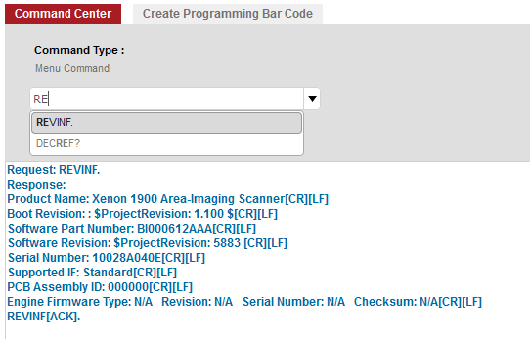
Query Commands -1
Besides commands to configure something in the scanner, there are also commands to retrieve information;
The command REVINF (revision info) provides essential product information;

Slide 11




Query Commands -2
To query the scanner on how commands are implemented on a specific scanning device there is also a set of query characters to query the commands their selves;
^ provides the command’s default setting
? Provides the command’s current setting
* Provides the command’s value options
- separator indicates a continuous value range
| separator indicates a non-continues list of values

Slide 12
Responses to serial commands
When scanning menu barcodes, the scanner will provide audible and visual feedback, to whether the command could be successfully executed.
When sending serial commands, the devices response with the following messages;
ACK for indicating the command was accepted
ENQ to indicate the TAG or SUB tag was not recognized (does not exist)
NAK Indicates that the command was recognized, but the parameter was invalid.

Slide 13
Trigger Commands
A scanner that is configured for manual trigger, can usually triggered with serial commands.
There is also a serial trigger mode where the trigger is disabled, and can strictly be triggered serially.
The following commands are used to serially trigger a scanner;
[SYN]T[CR] Trigger pressed
[SYN]U[CR] Untrigger (trigger released)
When serially triggered the scanner keeps scanning until:
A bar code was successfully decoded
The ‘Untrigger’ command is scanned
A configurable ‘read time out’ has expired

Slide 14


Available Serial commands
User Guide:
The User Guide is supposed to provide a full list of the supported Menu Commands.
EZConfig:
EZConfig supports a selection of menu commands, which means not all Menu commands might be supported. (does not read back from the device)
The selection of serial commands is not product depended, and you will see some unsupported options.
The implementation of a EZ-config selection can slightly differ per product.

Slide 15

Image commands
Besides reading barcodes, the camera equipped scanners, can use the scan engine to capture images.
A special set of imaging commands is available.
There is clear distinction between;
Capturing the image on the scanner (IMGSNP)
Transmitting the captured image, to a host (IMGSHP)
Transmitting an image to the host send a data stream of characters, where on the host an application is supposed to interpret the data as an image (EZConfig can do that)
Usually host initiated
Usually host initiated

Slide 16
Prefix and Suffix
To add a prefix or suffix the follow command syntax is used;
PREBK2 [Code ID ##][ASCII hex character ##]
SUFBK2 [Code ID ##][ASCII hex character ##]
Code ID
For Code ID a wild card entry 99 means apply to all symbologies
Code ID is a Honeywell internal indicator for the Symbology (listed in the User Guide)
Sample for [CR] suffix to all symbologies:
SUFBK2990D.

Slide 17

Complex Data Editing commands
To do more complex data manipulation referred to as;
Data Formatting, Data Editing and/or Data Parsing
Some serial commands utilize a more complex structure;
DFMBK3 0 099 99 9999 xxxxxxxxxxxxxxxxxxxxxxxxxxx………….
Primary/ alternate format
Terminal type
Code ID
Length
Editor commands
Editor commands are two character identifiers that instigate certain functionality with the Data Formatter, i.e. the editor command E9 : send all but the last nn characters from current position. That means it requires two parameters nn - i.e 02 for nn

Slide 18
Data Format Sample
To configure a data format to substitute/replace all occurrences of 'Horizontal Tab 0x09' by a 'Carriage Return 0x0D' and all occurrences of the character '1‘ 0x31 by the character 'A‘ 0x41.
DFMBK30099999999E404090D3141EAF7E900.
These values represent:
0 : add a primary data format.
099 : apply the format to all terminal types.
99 : apply the format to all symbologies.
9999 : apply the format to all barcode lengths.
E4 : replace characters.
04 : number of arguments of the E4 command.
09 : first character to be replaced (0x09, Horizontal Tab). 1
0D : character to be send as replacement (0x0D, Carriage Return). 2
31 : second character to be replaced (0x31, '1'). 3
41 : character to be send as replacement (0x41, 'A'). 4
EA : move cursor to the end, this invokes the E4 command.
F7 : move cursor to the beginning before sending the data.
E9 : send all but the last nn characters from current position.
00 : nn = 0 so send all characters

Slide 19
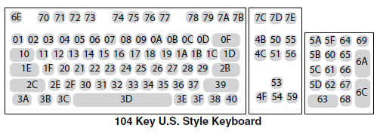
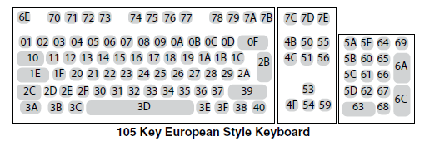
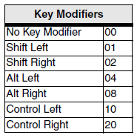
Modifier keys
The B5 editor command, allows to insert keystrokes including modifier / a combination of modifier keys.
Keys to be inserted; nn can be selected from the above keyboard layouts. With ss the modifier key for the to be inserted key is selected. The syntax is B5xxssnn and B5xxssnnssnnssnn…..for multiple key insertions, where xx indicates the amount of insert instances.
B501021F
inserts 01 character capital A (right-shifted a)

